Slide 1
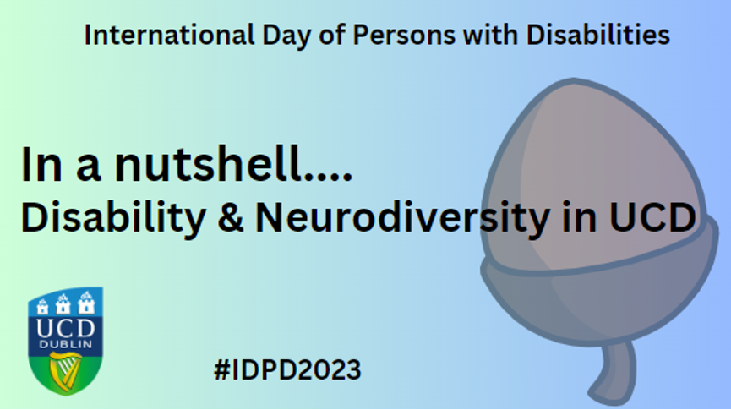


Slide 2
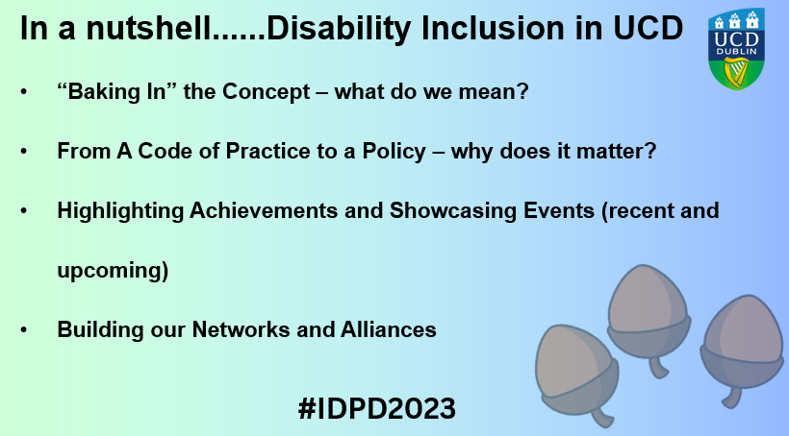

E: deirdre.oconnor@ucd.ie
Notes:
Text from slide:
In a nutshell......Disability Inclusion in UCD
“Baking In” the Concept – what do we mean?
From A Code of Practice to a Policy – why does it matter?
Highlighting Achievements and Showcasing Events (recent and upcoming)
Building our Networks and Alliances

Slide 3



In a nutshell....
  Text-to-Speech software
  Screen-masking and filters
  Captioning
Makes content more accessible / flexible
AT for Everyone:
SensusAccess file conversion.
Ally for Brightspace.
Office Suite – Immersive reader, Dictation.
Edge and Chrome browser – read aloud.
  Dictation software
  Screen-readers
  Radio aids
  Digital magnifiers
Facilitates participation
  Note-taking software
  Proof-reading software
Promotes
autonomy
#IDPD2023
E: emily.smith@ucd.ie
Notes:
Test from slide:
AT for Everyone:
SensusAccess file conversion.
Ally for Brightspace.
Office Suite – Immersive reader, Dictation.
Edge and Chrome browser – read aloud.
Accessible/flexible content
Text-to-Speech software
Screen-masking and filters
Captioning
Facilitates participation
Dictation software
Screen-readers
Radio aids
Digital magnifiers
Promotes autonomy
Note-taking software
Proof-reading software

Slide 4
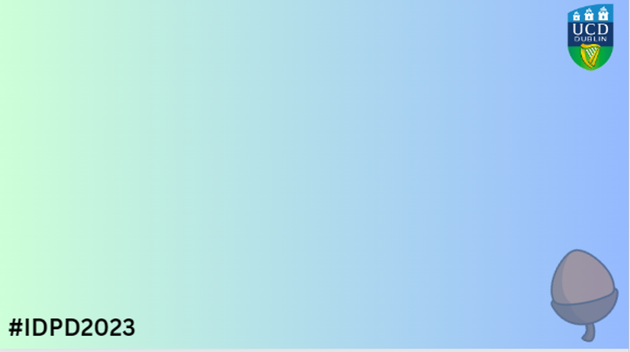


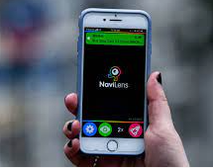
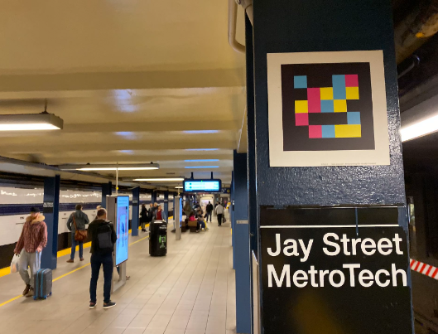

NaviLens
Like QR codes but better! They embed real-time information.
A single code can assist with navigation in multiple directions, depending on the angle the smartphone camera is viewing the code, i.e., which way the user is orientated and moving through space.
Public transport: e.g., in some cities in Spain, London, New York City
NaviLens in Ireland
Vision Ireland sites in Drumcondra, Tallaght, Camden St, Cork Office
Irish Rail commuter trains pilot,
Museums and galleries e.g. The Hunt Museum,
On retail packaging (Unilever, Kelloggs)
In a nutshell....
#IDPD2023
The app is free to download (Android and iOS)
Translates into 40+ languages
www.ucd.ie/all/aboutus/campusaccessibility/
E: tina.lowe@ucd.ie
Notes:
NaviLens
Like QR codes but better! They embed real-time information.
A single code can assist with navigation in multiple directions, depending on the angle the smartphone camera is viewing the code, i.e., which way the user is orientated and moving through space.
Public transport: e.g., in some cities in Spain, London, New York City
NaviLens in Ireland
Vision Ireland sites in Drumcondra, Tallaght, Camden St, Cork Office
Irish Rail commuter trains pilot,
Museums and galleries e.g. The Hunt Museum,
On retail packaging (Unilever, Kelloggs)
Navilens est. in Spain, 2018.
Drumcondra head office & training centre, Tallaght office, Camden Street retail) and Cork (Penrose Wharf office)
NaviLens is suited to use not only by people who are blind or have low vision but also international visitors.
The app is free to download (Android and iOS)
Translates into 40+ languages
www.ucd.ie/all/aboutus/campusaccessibility/
Contact: : tina.lowe@ucd.ie

Slide 5
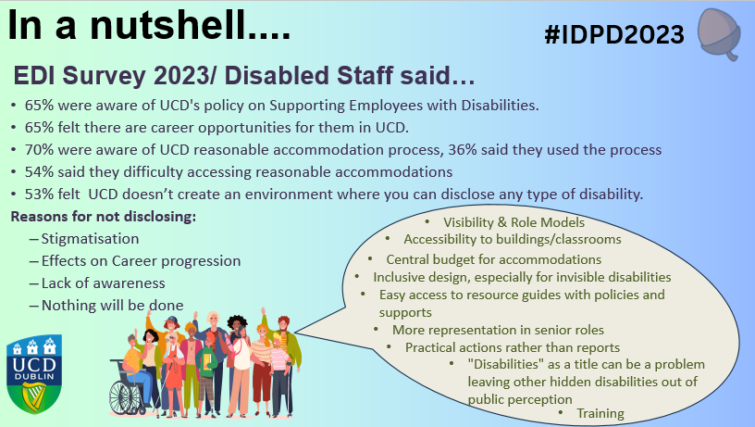
E: tom.costelloe@ucd.ie
Notes:
Test from slide:
65% were aware of UCD's policy on Supporting Employees with Disabilities.
65% felt there are career opportunities for them in UCD.
70% were aware of UCD reasonable accommodation process, 36% said they used the process
54% said they difficulty accessing reasonable accommodations?
53% felt UCD doesn’t create an environment where you can disclose any type of disability. Reasons for not disclosing include:
Stigmatisation
Effects on Career progression
Lack of awareness
Nothing will be done
As a line manager/head of school, do you feel you receive enough guidance and resources to support employees with a disability(s) 54% SAID NO /46% SAID YES
If you have a disability, do you feel that your line manager/head of school understands how they can support people with disabilities to reach their full potential? 46% SAID NO AND 54% SAID YES
12% response rate from those employees with a disability
Speech bubble question: In your opinion, how can UCD create a more inclusive work environment for those with a disability(s
“Language” in speech bubble refers to the free text stating - Disabilities" as a title can be a problem leaving other hidden disabilities out of public perception. Visibility, representation at senior level UMT, accessible buildings and classrooms, easy access to resources, guides policies and supports related to disability, central budget for accommodations, roles models.
: tom.costelloe@ucd.ie -

Slide 6
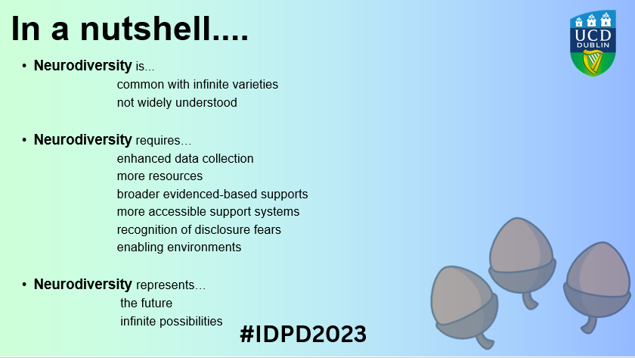
E: blanaid.gavin@ucd.ie
Notes:
Text from slide:
Neurodiversity is...
common with infinite varieties
not widely understood
Neurodiversity requires…
enhanced data collection
more resources
broader evidenced-based supports
more accessible support systems
recognition of disclosure fears
enabling environments
Neurodiversity represents…
the future
infinite possibilities

Slide 7
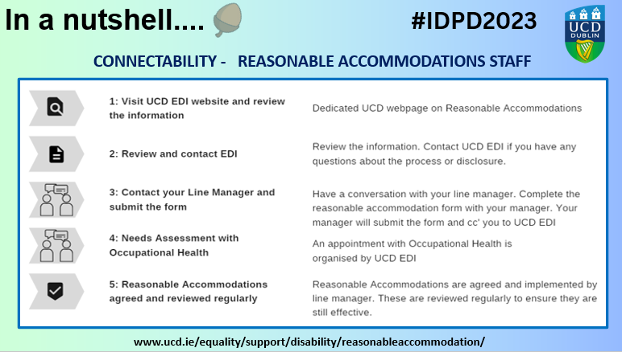
E: edi@ucd.ie
Notes:
Reasonable Accommodation in UCD
UCD’s reasonable accommodations process was developed through the ConnectAbility project.
This project was an intervarsity project (7 Universities)
involved staff survey (10% response rate in UCD)
focus group
audit of policies and procedures.
The process supports staff with disabilities in the workplace in relation to disclosing a disability and seeking a reasonable accommodation.
To access reasonable accommodations visit the EDI webpage: https://www.ucd.ie/equality/support/disability/reasonableaccommodation/
Contact edi@ucd.ie

Slide 8
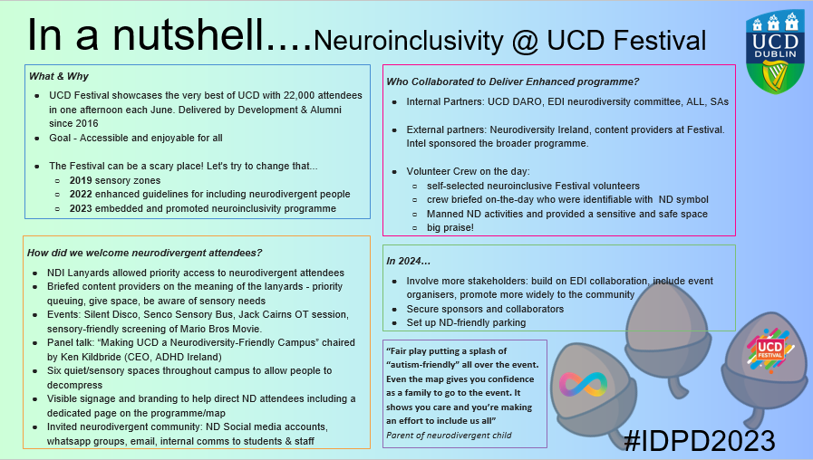
E: simon.gray@ucd.ie
E: jennie.blake@ucd.ie
Notes:
Text in slide
Neuroinclusivity @UCD Festival
What & Why
UCD Festival showcases the very best of UCD with 22,000 attendees in one afternoon each June. Delivered by Development & Alumni since 2016
Goal - Accessible and enjoyable for all
The Festival can be a scary place! Let's try to change that...
2019 sensory zones
2022 enhanced guidelines for including neurodivergent people
2023 embedded and promoted neuroinclusivity programme
Who Collaborated to Deliver Enhanced programme?
Internal Partners: UCD DARO, EDI neurodiversity committee, ALL, SAs
External partners: Neurodiversity Ireland, content providers at Festival. Intel sponsored the broader programme.
Volunteer Crew on the day:
self-selected neuroinclusive Festival volunteers
crew briefed on-the-day who were identifiable with ND symbol
Manned ND activities and provided a sensitive and safe space
big praise!
How did we welcome neurodivergent attendees?
NDI Lanyards allowed priority access to neurodivergent attendees
Briefed content providers on the meaning of the lanyards - priority queuing, give space, be aware of sensory needs
Events: Silent Disco, Senco Sensory Bus, Jack Cairns OT session, sensory-friendly screening of Mario Bros Movie.
Panel talk: “Making UCD a Neurodiversity-Friendly Campus” chaired by Ken Kildbride (CEO, ADHD Ireland)
Six quiet/sensory spaces throughout campus to allow people to decompress
Visible signage and branding to help direct ND attendees including a dedicated page on the programme/map
Invited neurodivergent community: ND Social media accounts, whatsapp groups, email, internal comms to students & staff
In 2024…
Involve more stakeholders: build on EDI collaboration, include event organisers, promote more widely to the community
Secure sponsors and collaborators
Set up ND-friendly parking
“Fair play putting a splash of “autism-friendly” all over the event. Even the map gives you confidence as a family to go to the event. It shows you care and you’re making an effort to include us all”
Parent of neurodivergent child

Slide 9
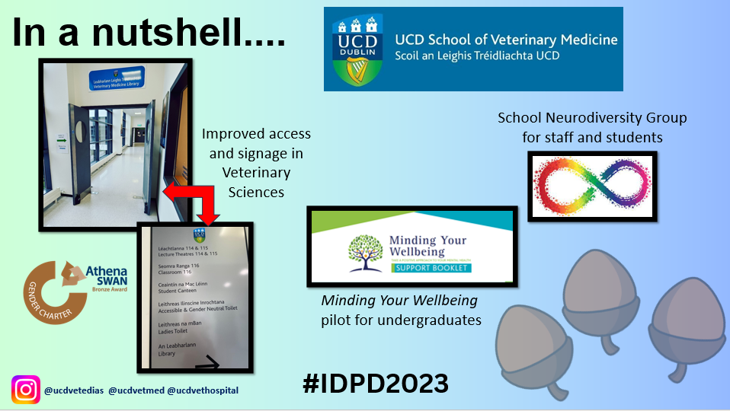
E: eimear.burkley@ucd.ie
Notes:
Images of UCD Vets accessible building, the school’s Neurodiversity staff and student group. Contact SVM for more information: eimear.burkley@ucd.ie

Slide 10


15 episodes
Get the lowdown on equality and access, on accessible-first designs, and discover how good design benefits everyone. Thinking about 'inclusion first' opens the world.
Great designs, amazing technologies and good policies improve the lives of everyone, in communities, places, spaces, landscapes, buildings, technologies and more. This podcast focuses on real people facing real challenges that can and will be fixed.
On Apple Podcast player & Spotify
Notes:
15 episodes
Get the lowdown on equality and access, on accessible-first designs, and discover how good design benefits everyone. Thinking about 'inclusion first' opens the world.
Great designs, amazing technologies and good policies improve the lives of everyone, in communities, places, spaces, landscapes, buildings, technologies and more. This podcast focuses on real people facing real challenges that can and will be fixed.
Links below via Apple Podcast player and Spotify
https://podcasts.apple.com/ie/podcast/the-blind-spot/id1618448409
https://open.spotify.com/show/6u4nVtp0UgxdvrA6yIIUwI?si=c4fb576400aa4c

Slide 11


What’s Your Nutshell?
Share your nutshell edi@ucd.ie
Join the cluster ☺
Notes:
What’s Your Nutshell?
Share your nutshell edi@ucd.ie
Join the cluster ☺
(Instructions and templates on slide 14 and 15)

Slide 12
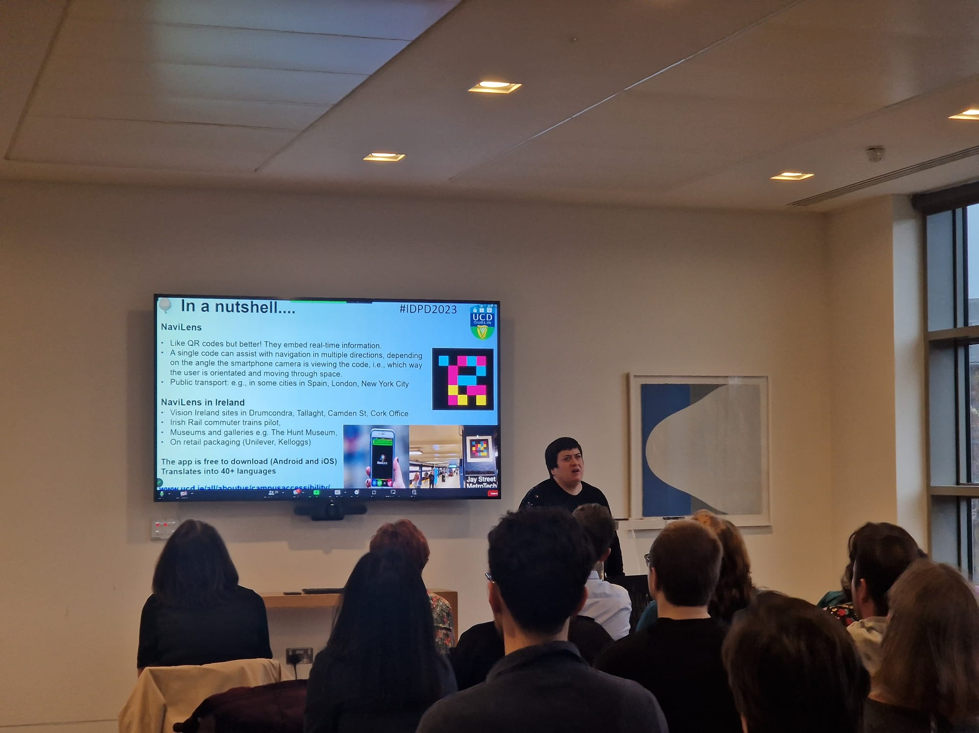
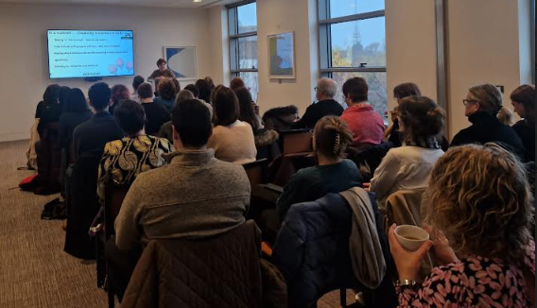
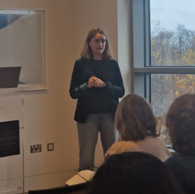
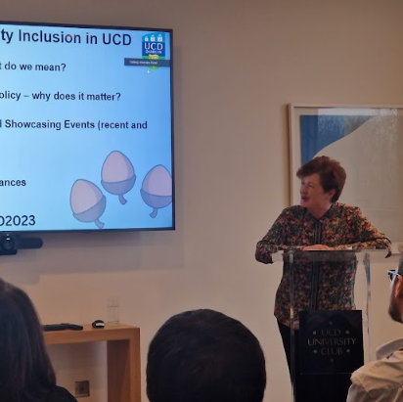
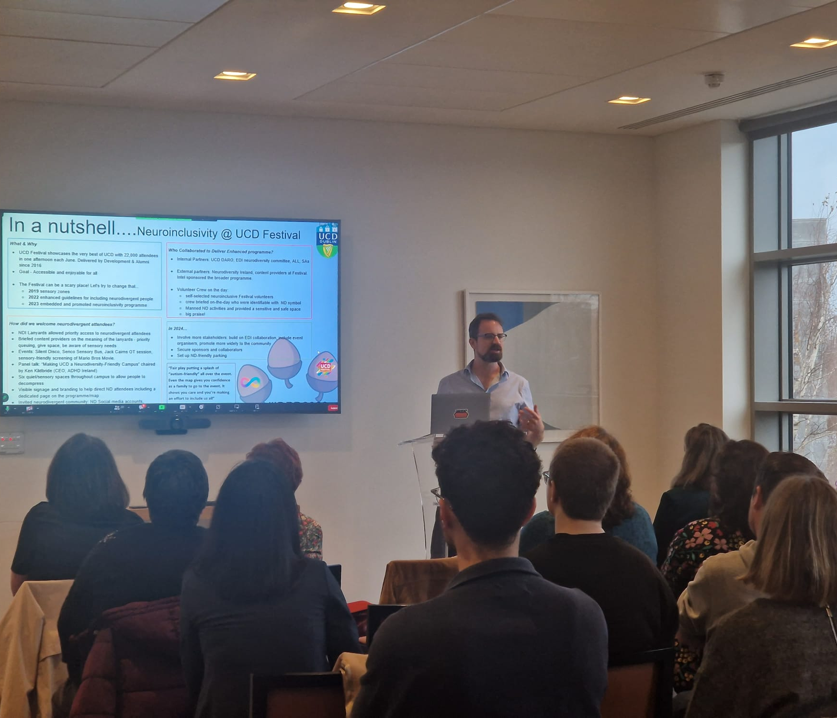
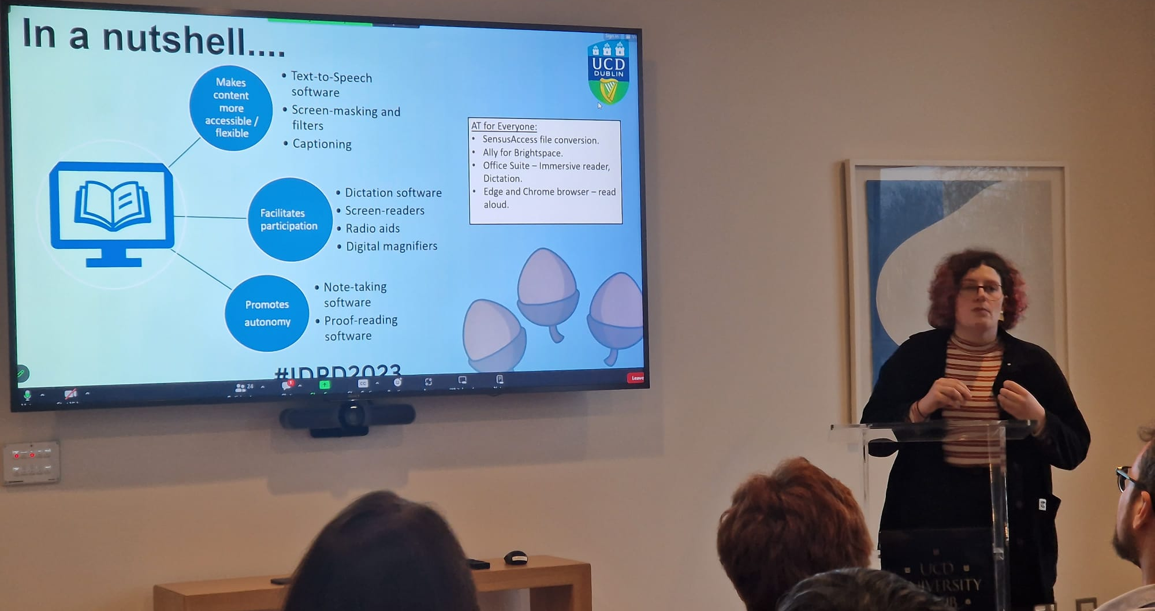
THANK YOU
#IDPD23
Notes:
Thank you and Photos of the event

Slide 13
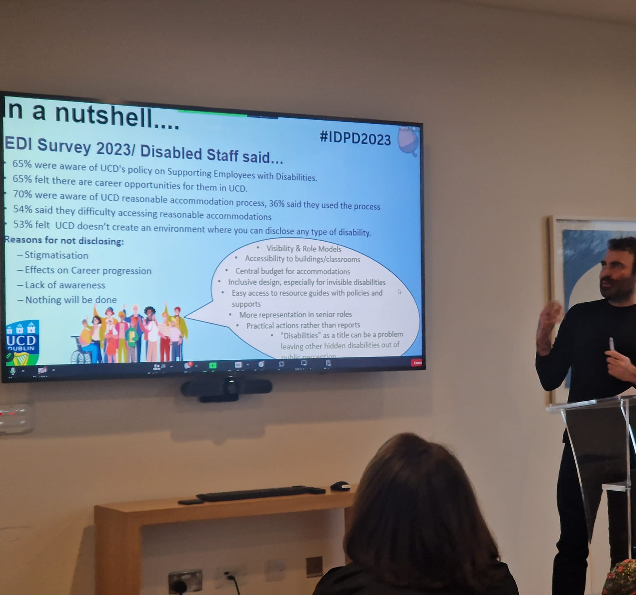

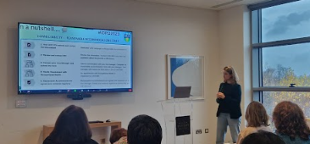
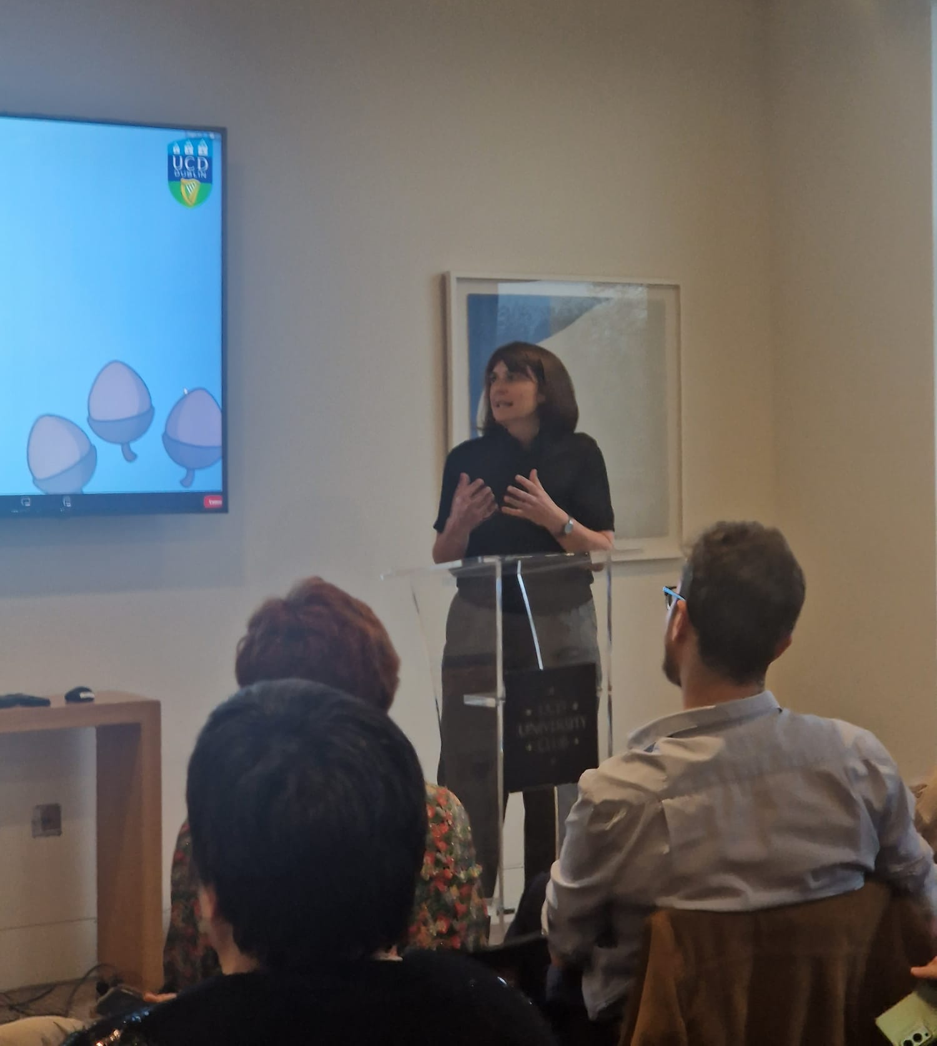
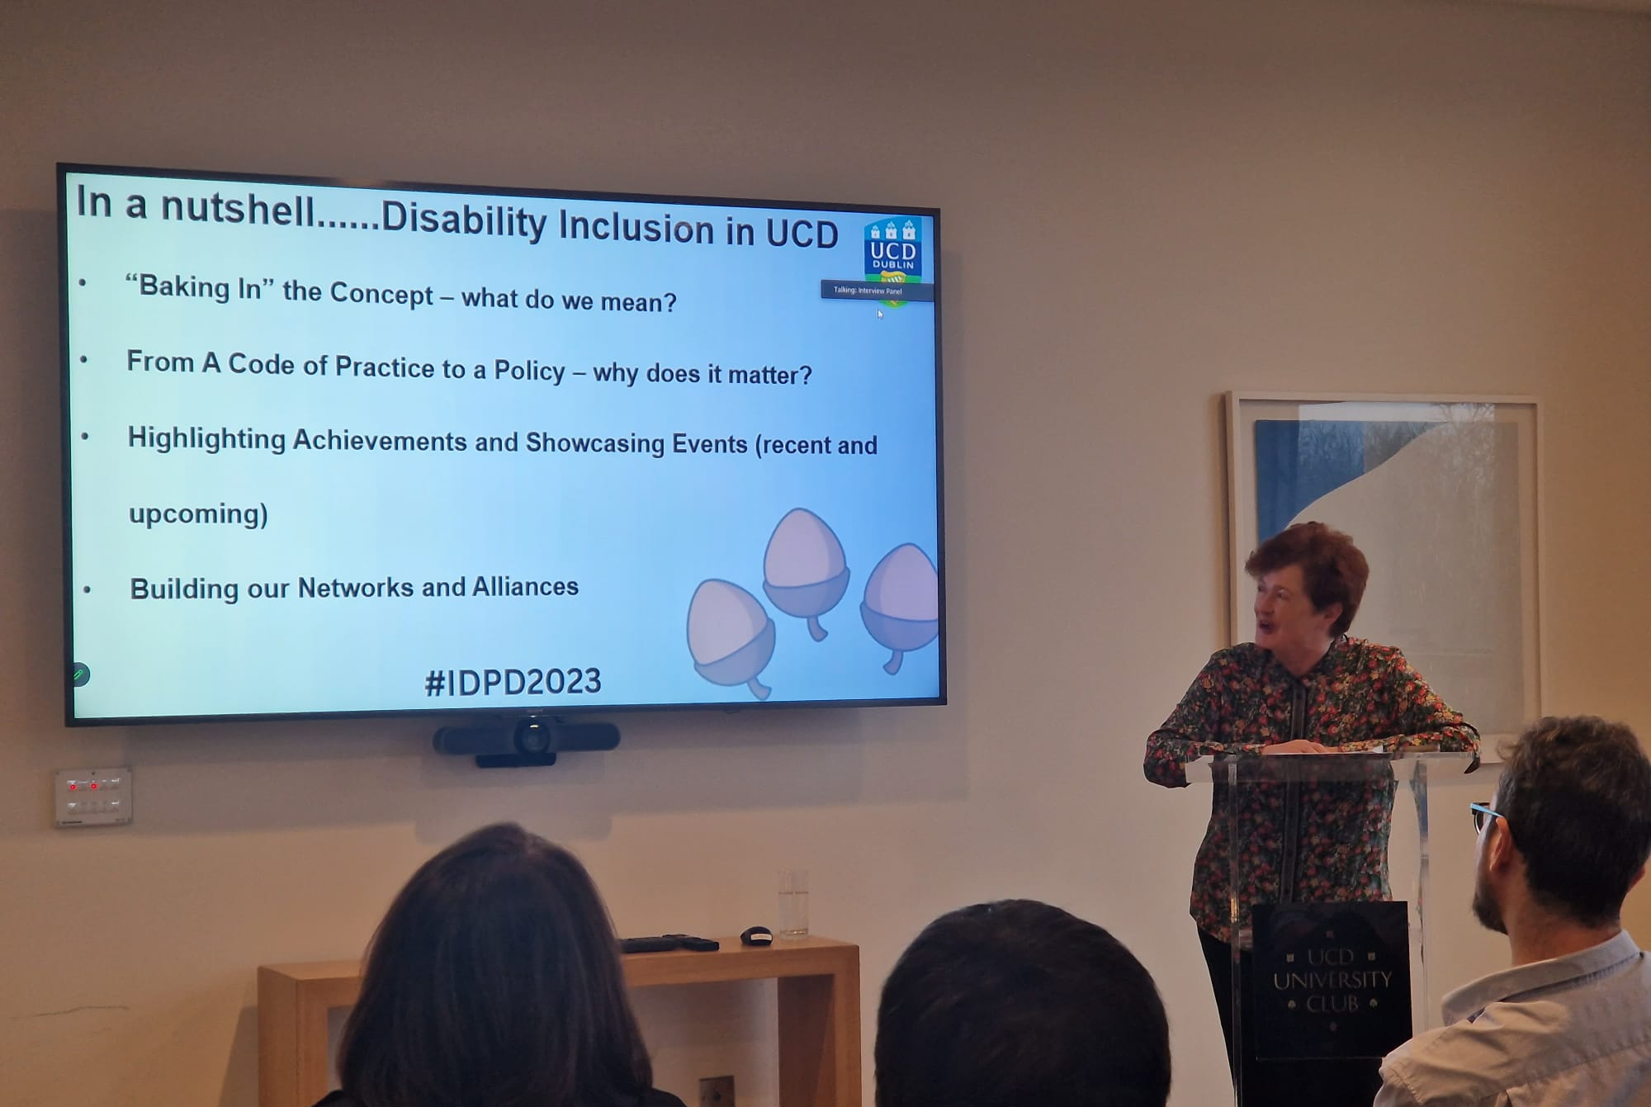
IDPD 2023
THANK YOU
Notes:
Photos of the event

Slide 14
Share a project, initiative, research or support
you are working on in UCD related to disability, neurodiversity inclusion and accessibility.
Record a 60 sec video. You can use the next slide as a background if you wish. You can find examples of recording on the UCD EDI IDPD webpage
Create a powerpoint slide using the templates on the next slides.
Share your nutshell edi@ucd.ie
Notes:
Nutshell instructions: Share a project, initiative, research or support
you are working on in UCD related to disability, neurodiversity inclusion and accessibility.
Record a 60 sec video. You can use the next slide as a background if you wish. You can find examples of recording on the UCD EDI IDPD webpage.
Create a powerpoint slide using the templates on the next slides.

